Slide 1

Coordinated Student Health Services
Marcia Bynoe, ARNP-BC, MSN, FNP, SNP
Director, Coordinated Student Health Services
Broward County Public Schools

Slide 2
Coordinated Student Health Services
Mission Statement
Coordinated Student Health Services (CSHS) strives to foster growth, development, and educational achievement of our students by promoting their health and wellness in a safe supportive environment. CSHS embraces collaboration with staff, students, families and the community to achieve this goal.
Notes:
CSHS Mission

Slide 3
Purpose
Provide an overview of the School Health Program Staffing Model
Provide an understanding of staffing for 2019-2020 school year
Identify the gaps in the current School Health Program
Demonstrate the need for professional licensed (RN’s) in all schools

Slide 4
Overview of Student Health Services
Communicable & Infectious Diseases Control Management
State Mandated CORE Health Requirements
Immunization Compliance
Health Screenings For Students – vision, hearing, scoliosis & BMI
Nursing Services - case management, health consultation & trainings
Medically Fragile Services
Chronic Disease Management & Care Coordination
CPR/AED/First Aid Training - American Heart Assoc. Training Ctr.
Mental Health
Health Partnerships
Health & Wellness Promotion/Education, Community Outreach
District-wide Medication Administration training & standards

Slide 5
Differentiated Staffing School
Health Model ( DSSHM)
Implemented in 2009-2010 school year
Designed to meet the growing health needs of the student population while improving the utilization of funding
Increase the number of schools and students receiving health services
Decrease the number of students sent home from school, therefore increasing students academic time
Notes:
Model started as a Pilot in 2009

Slide 6
DSSHM Delivery Model
Model includes three levels of health services:
RN/LPN’s – provide care of students with chronic health conditions/high priority health needs
Health Support Technicians (HST’s) with RN supervision – provide care of students requiring basic health services
On-Call – available services to identified schools with RN consultation
Notes:
RN/LPN – provide higher level of acuity of care for students with chronic health conditions
Students with diabetes and other health conditions
HST/RN – 1: 5 ratio RN:5HST’s – provide care for students with basic health needs and with RN supervision

Slide 7
School Health Partners
Florida Department of Health – Broward
Children’s Services Council (CSC)
Nova Southeastern University
Memorial HealthCare System
Jersey College
Notes:
FDOH Broward provides approx.- 1.3 million for School Health services
CSC – 1.6 million for their staffing of healthcare personnel in schools

Slide 8
On-Call Nursing
Notes:
Here you see the decrease with the number of schools without a healthcare personnel
In 2015-2016 school year we had 53 schools w/o healthcare personnel on site. 2019- only 5 schools On- call

Slide 9
Health Care Personnel available in BCPS during 2019/20
Notes:
This is a gap in our service delivery. Although we have 226 schools covered. We have 198 schools with contracted agency personnel which creates hardship with continuity of care and oversight. We require 1:10 ratio for supervision. We have only 28 school board nurses

Slide 10
Summary of On-site Health Care Personnel & Funding Partners
2019 - 2020
Notes:
Summary of on- Site health services – 226 schools with some level of healthcare personnel.
Chronic Health Program – 85 contracted nurses paid by SBBC & 28 SBBC employed nurses.
CSC- provides 9 RN’s and 55 HSTs with RN supervision 1:5 ratio
FDOH- provides 3 RN’s and 45 HST’s with RN supervision 1:5 ratio
The 5 schools ON- Call – 1 RN from FDOH provides support to those schools.

Slide 11
Chronic Health Conditions
July 2018 – June 2019
School Health Annual Report
69,252 students with Chronic Health Conditions in our schools
      ADHD/ADD – 5,425
      Allergies (life threatening) – 1,013
      Allergies (non-Life threatening) – 40,025
      Asthma – 19,837
      Autism spectrum disorders – 6,029
      Bleeding disorders – 210
      Cancer – 120
      Cardiac conditions – 1,465
      Cystic fibrosis – 23
      Diabetes – 644
      Seizure disorder – 1,669
      Kidney disorders – 127
      Mental/behavioral health conditions – 1,003
      Sickle cell disease – 553
      Others – 2,457
Notes:
Growing number of students with chronic health conditions 69,000.

Slide 12
Diabetes Trends in BCPS
Notes:
2017-2018 = 271 reported students 2019-2020 = 540 reported students
2018-2019 = 550 reported students

Slide 13
Gaps in School Health Services
Increased number of students with chronic health issues/complex medical problems requiring a higher acuity level of care by a professional RN
100 schools assigned HST’s (unlicensed personnel)
28 BCPS nurses
198 schools staffed with contracted healthcare personnel - creates lack of continuity and care coordination
Requires additional oversight of contracted healthcare personnel by the BCPS District staff
Notes:
GAPS –1. Increase number of students with chronic health conditions which require RN/LPN professional care
2. Out of the 226 schools with on – site health care – we have 198 schools staffed by agency – creates lack of continuity of care and need for additional oversight

Slide 14
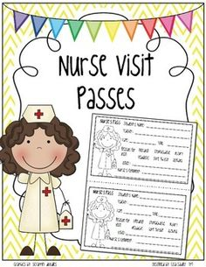
Health Services in Schools
STATE MANDATED HEALTH SCREENINGS
Average Student Health Room visits
  Daily - 78,443
Average Medication Doses Administered
  Daily - 24,561
Health Screenings - 191,571
(Vision, Hearing, BMI & Scoliosis )

Slide 15
Why a Nurse ?
Nurse has a pivotal role to improve the health and education outcomes of students
Promoting life-long healthy behaviors from an early age
Reducing health risks & identify mental health conditions
Identification & monitoring of student’s health care
Decrease absenteeism & improve learning
Identify and respond to treatment and health care needs for children with chronic health conditions and acute care health care needs

Slide 16
Registered Nurses (RN’s) are needed in schools
A student’s health is directly related to his/her ability to learn
Children with unmet health needs have difficulty engaging in the educational process
RN - supports student success by providing health care through assessment, interventions, referrals and follow-up
RN - addresses the physical, mental, emotional, and social health needs of students

Slide 17
Budget

Slide 18
504 PLANS
# Students with Districtwide 504 Plans – 7,088
# Students with Diabetes 504 Plans – 341
Each student with a chronic health condition is assessed to determine if a 504 Plan is needed; if it is determined the healthcare personnel will follow-up with the 504 liaison at the school.

Slide 19
Notes:
Increase in the number of 504 Plans being completed districtwide 2018- 6,272 vs 2019 – 7,088
Diabetes 2018- 333 vs 2019- 341
We have placed a check box for 504 on the IHCP and the on- site health care personnel must initiate with the school 504 liaison to begin the process.

Slide 21
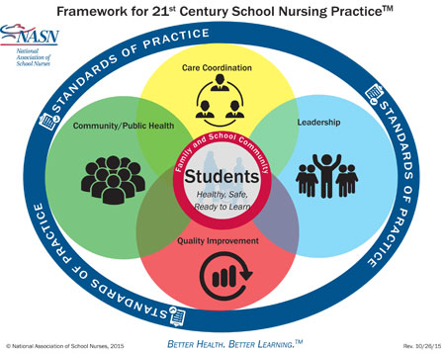

Slide 22

Coordinated Student Health Services

